Slide 1
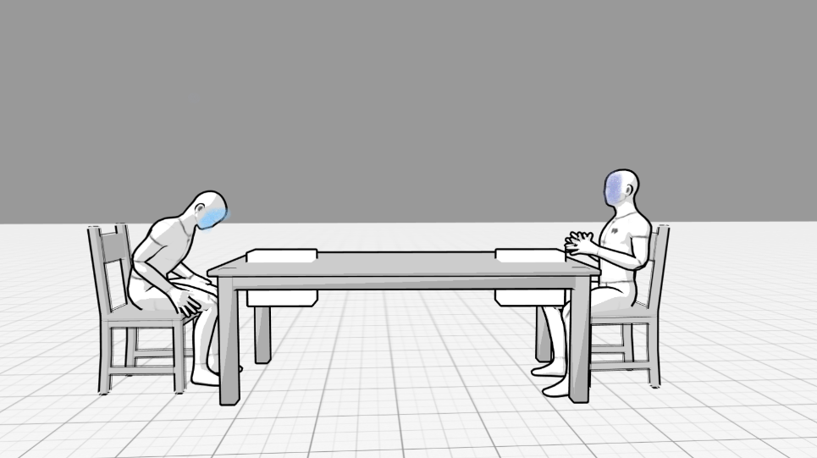
Weak character and strong character sat at a table each with papers in front before and interview. Weak character is hunched over and strong character is sitting confidently

Slide 2
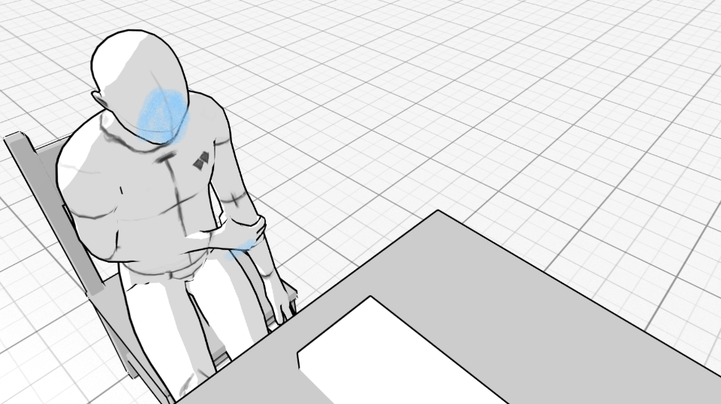
Weak character high angle shot of them rubbing their arm anxiously

Slide 3
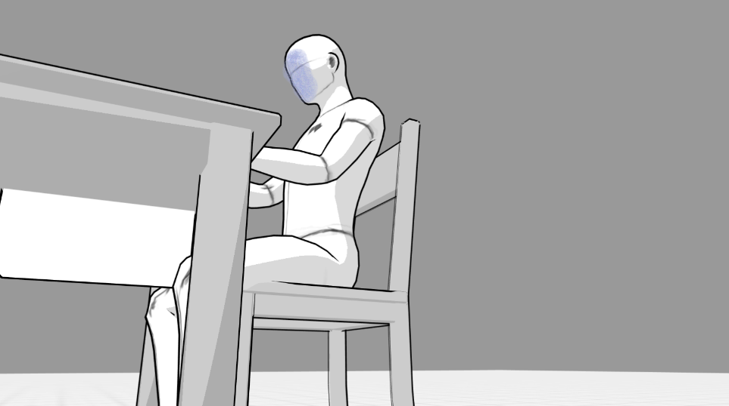
Strong character low angle shot of them sitting confidently

Slide 4
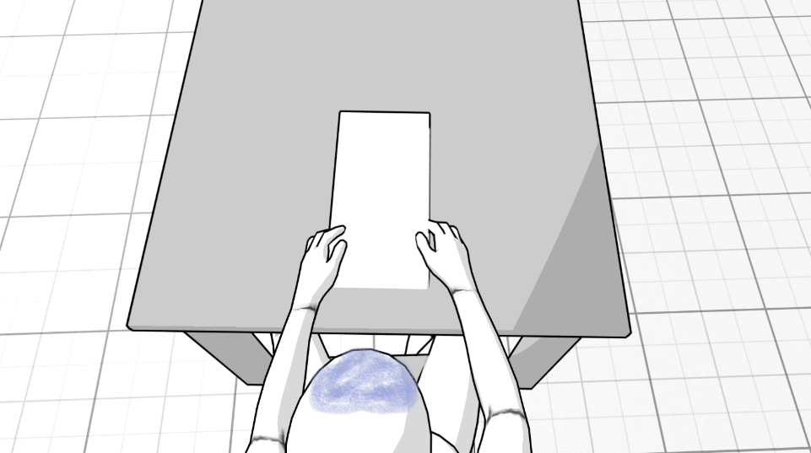
Overhead shot of strong character going through the papers in front of them

Slide 5
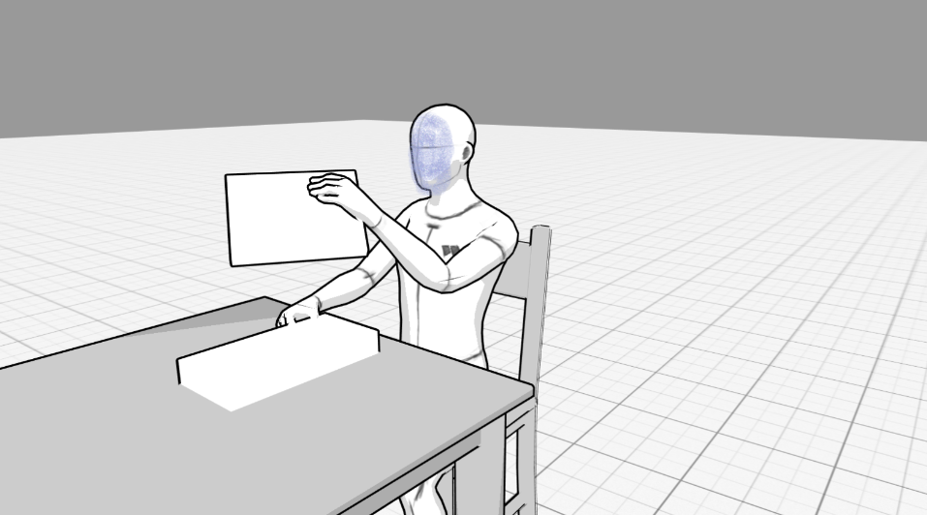
Strong character handing the weak character a sheet of paper to read

Slide 6
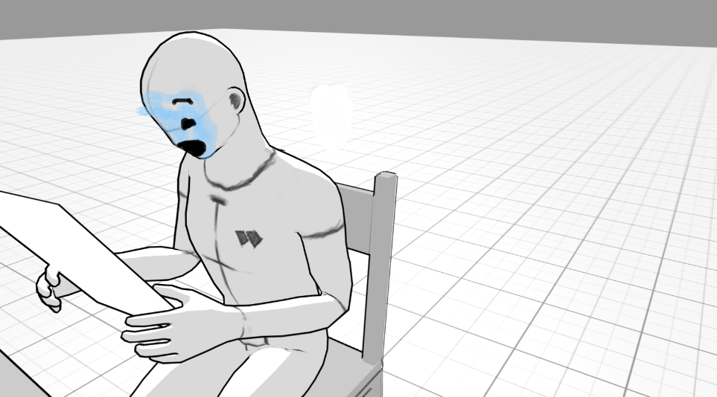
Weak character looks shocked because of what is on the paper

Slide 7
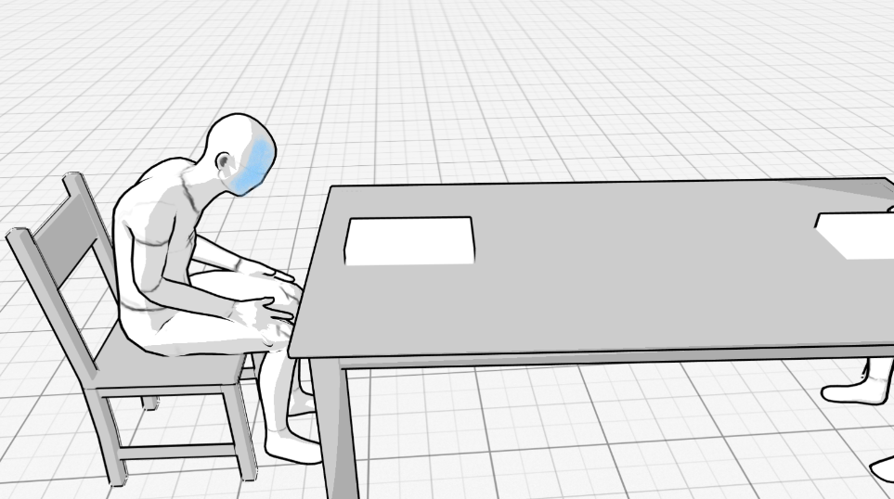
Weak character is sad and unconfident

Slide 8
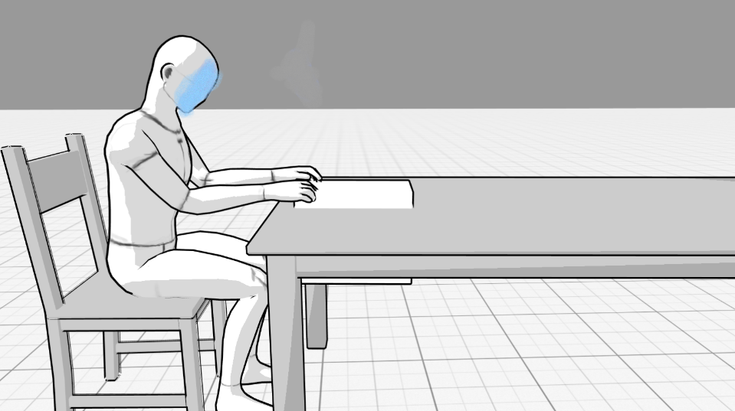
Weak character starts going through their papers in front of them

Slide 9
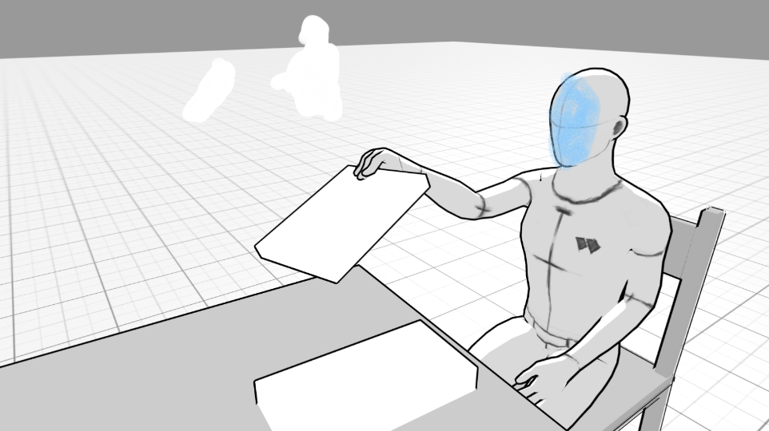
Weak character hands the strong character a sheet of paper to read

Slide 10
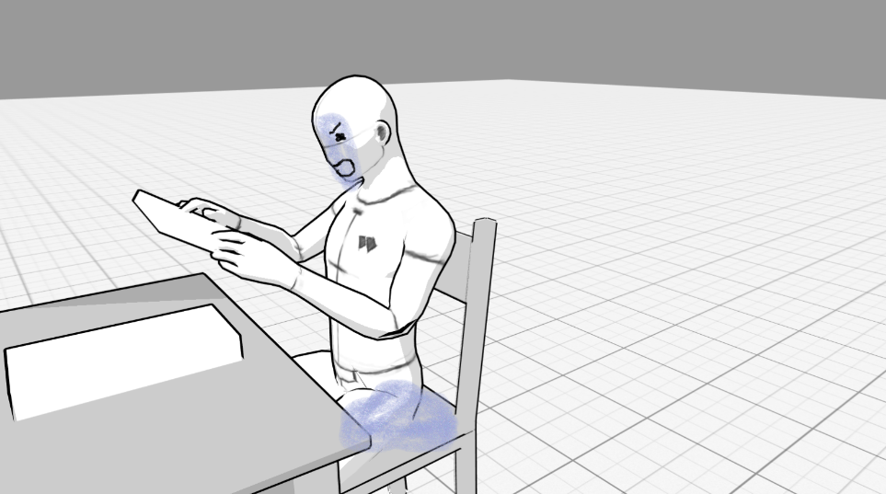
The strong character is angry because of what it says on the paper

Slide 11
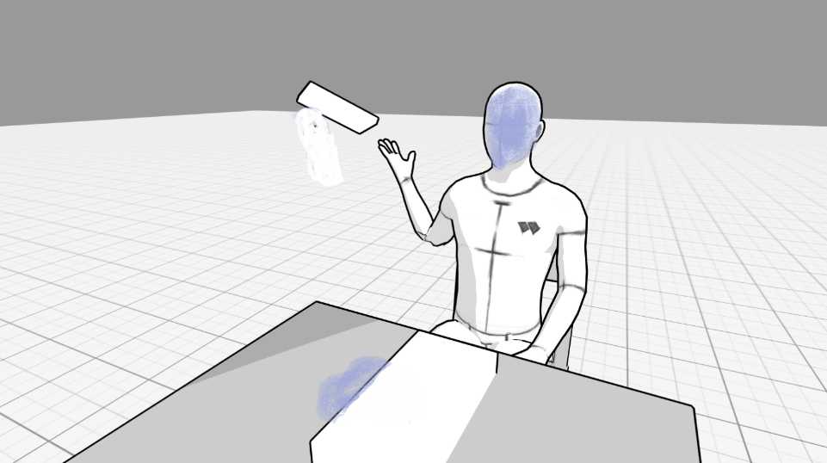
The strong character tosses the paper away out of frustration

Slide 12
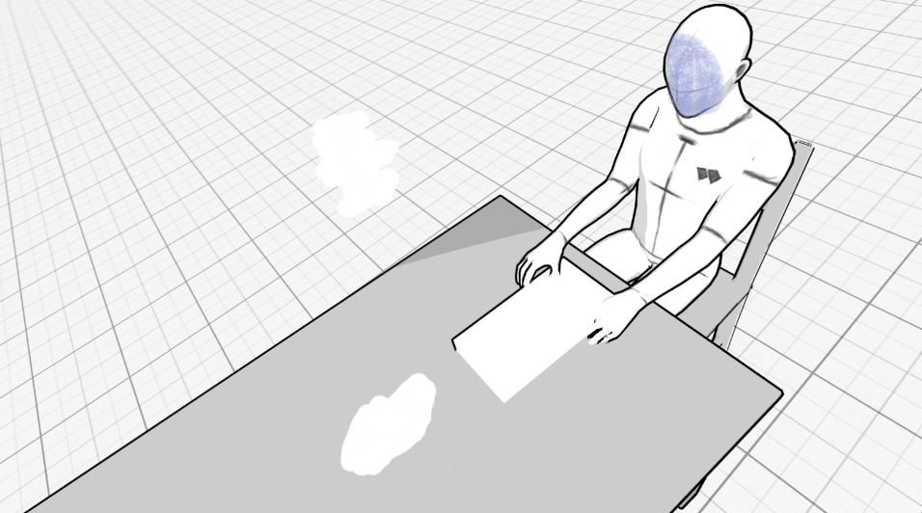
Strong character starts to go through their papers again, but with a high angle to show their increasing weakness

Slide 13
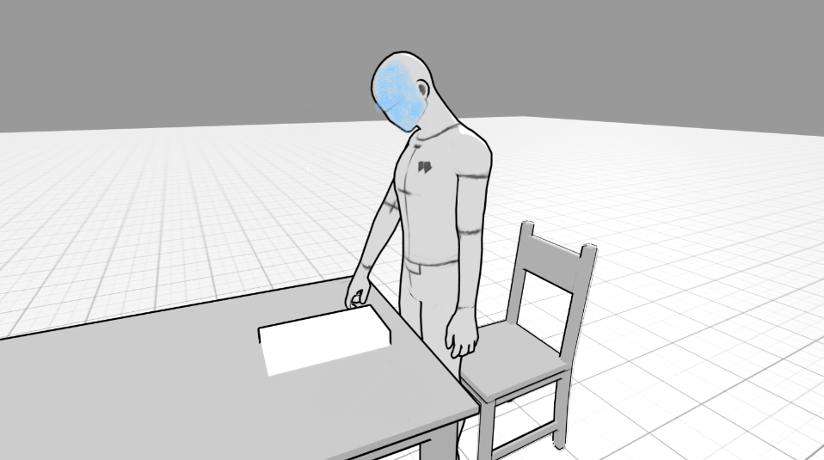
The roles have now switched and the weak character who is now the strong character stands up and picks up another sheet of paper

Slide 14
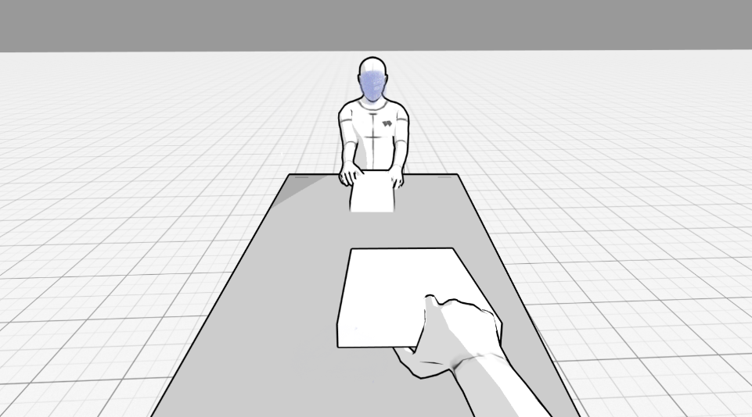
pov of the new strong character handing the new weak character a sheet of paper

Slide 15
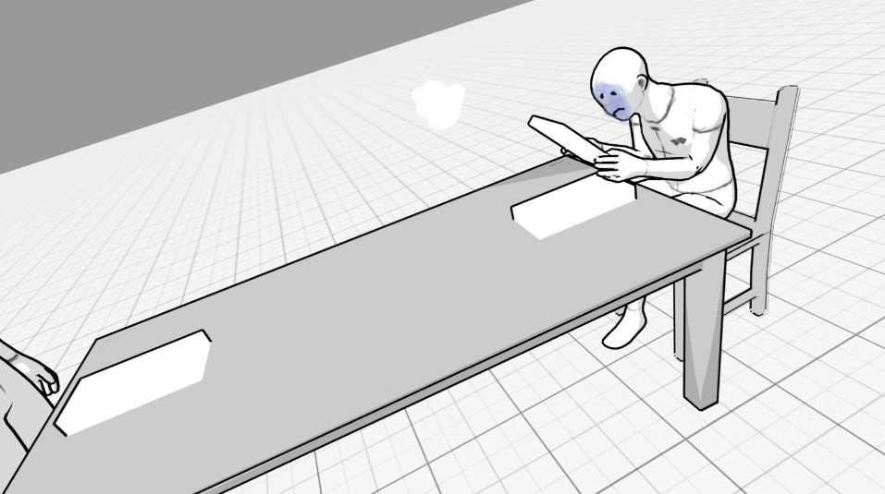
The new weak character reads it sadly while hunched over

Slide 16
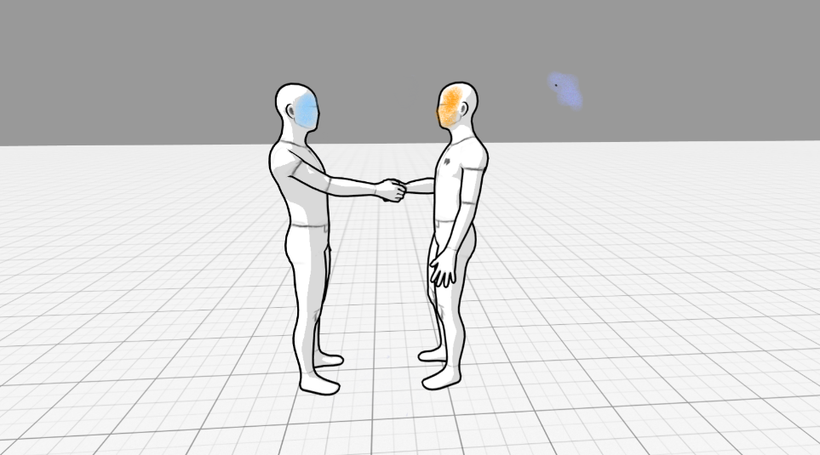
The new strong character has walked off and is now greeting the interviewer

Slide 17
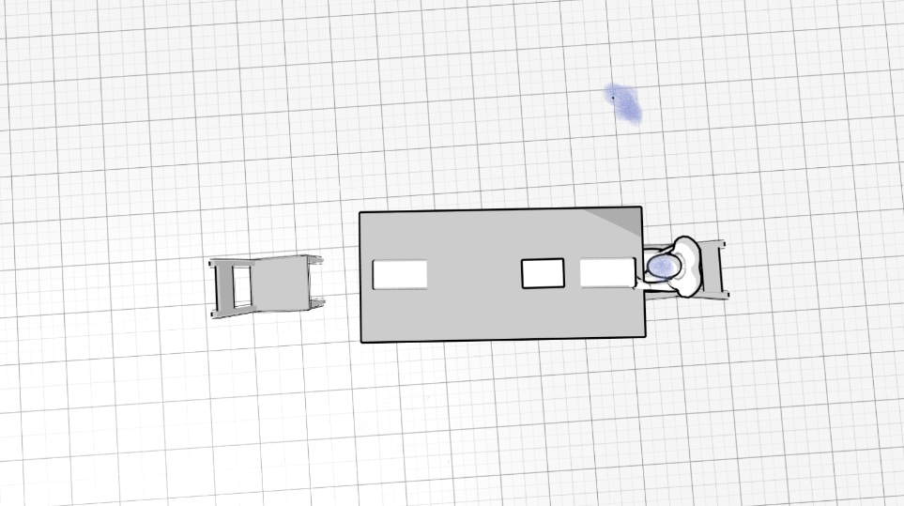
Overhead shot showing the new weak character isolated

Slide 18
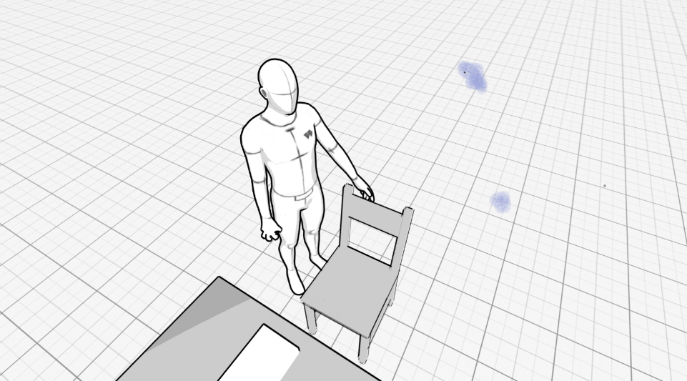

New weak character gets up out of their chair angrily

Slide 19
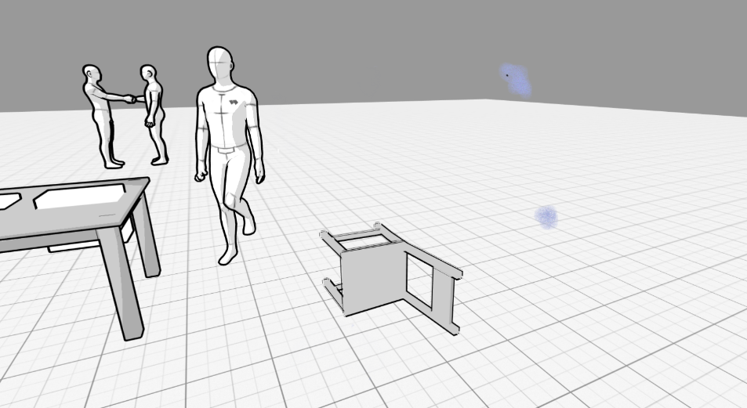
New weak character throws their chair in a fit of rage and stomps their foot as the new strong character is greeting the interviewer in the background

