Slide 1
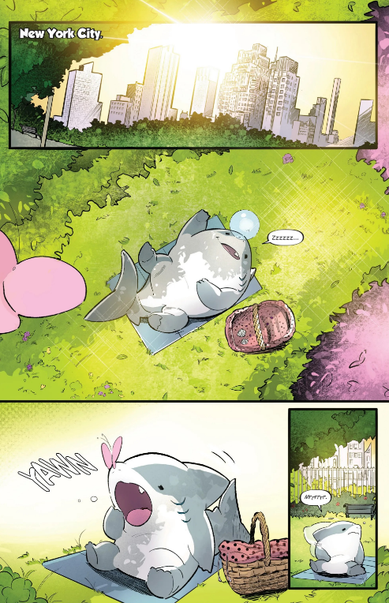
narrator
Light, happy music and vibe
Birds chirping
People talking and traffic noise
Children laughing and playing

Slide 2
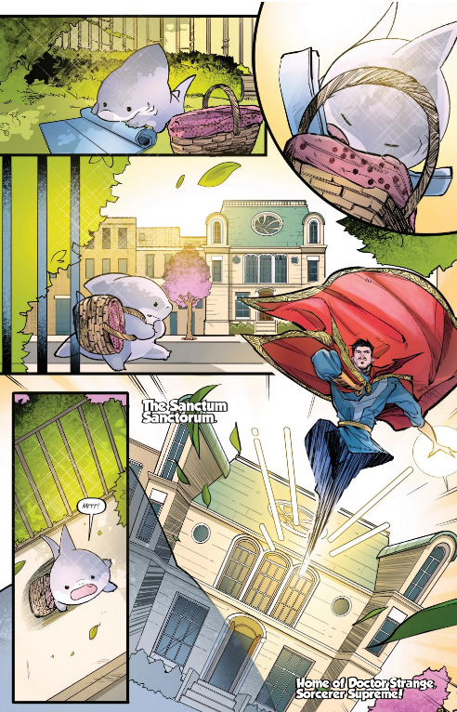
Fabric moving
Basket moving
Heroric sound effect
Music fades
Basket dropping
narrator

Slide 3
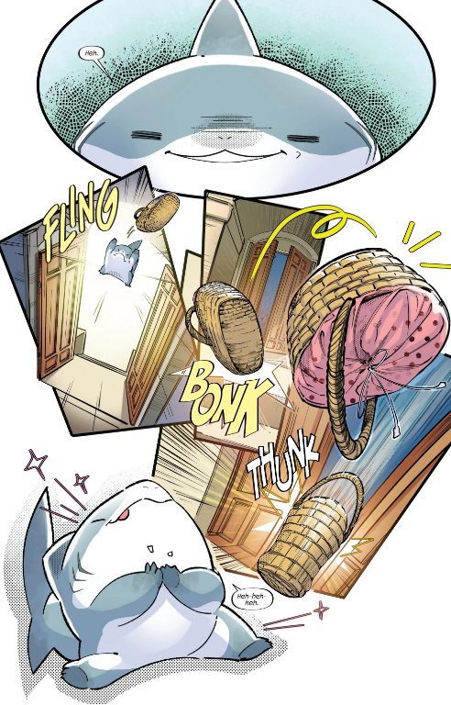
Sneaky music
Doors swinging open and hitting the wall
Sparkling noises
Music fades

Slide 4
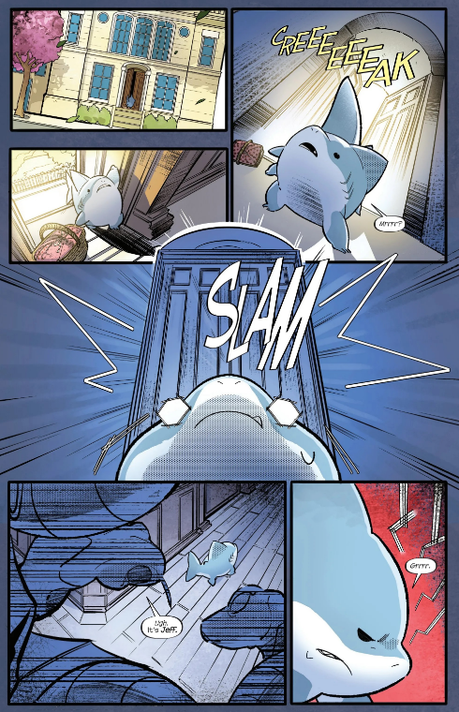
Slow, suspenseful music
Snake hisses before dialouge
Thunder noise
Padding footsteps
Snakes speak with lengthened s’s

Slide 5
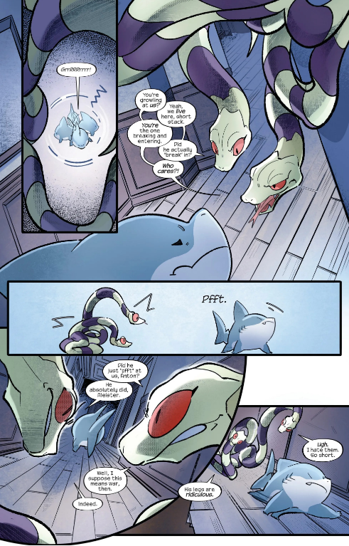
whimpering
Snakes both go huh? After “pfft”
Slithering noises
Padding walking noises
Jeff goes hm! After they both speak

Slide 6
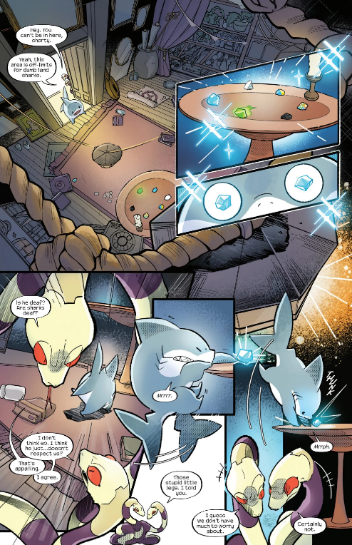
Doors creaking open
Sparkling sounds
whoaaaa
Music fades
Snakes both go “heh heh heh” after “certainly not”

Slide 7
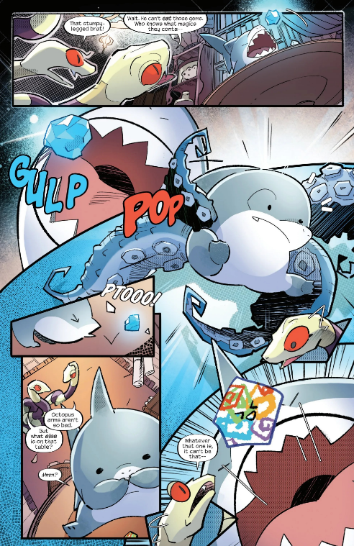
One snake gasps before “that stumpy legged brat”
Small scream
Munch noise and “Nom nom nom”

Slide 8
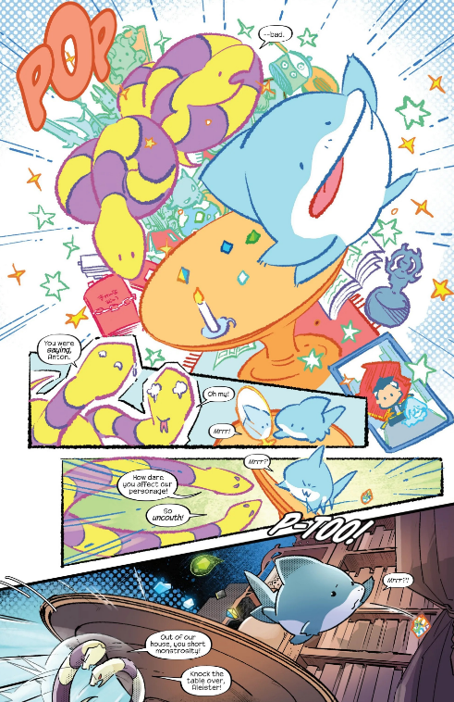
Sparkling sounds
explosion
Dialogue becomes high pitched

Slide 9
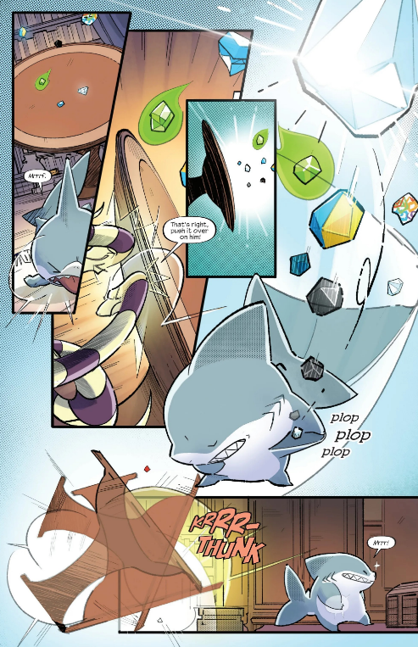
Clinking noises
Thump or splat noise of jeff hitting the floor before “mrrf”

Slide 10
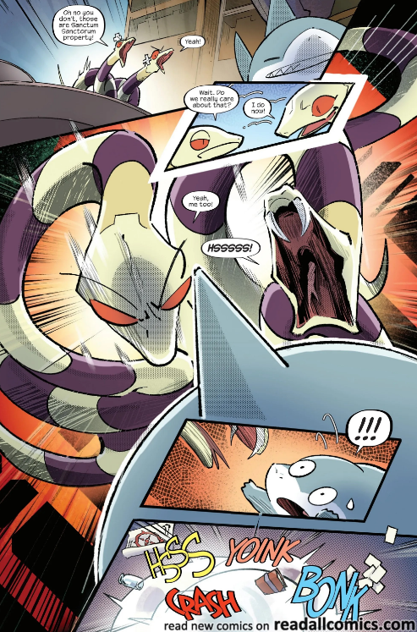
Intense scary music starts
Thunder noises
Yelping noise
Shuffling of fighting

Slide 11
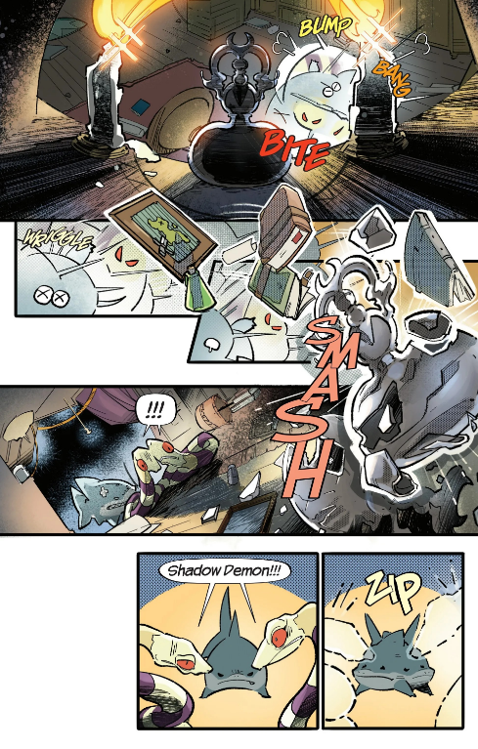
Shuffling of fighting
Jeff whimpering
Glass smashes 1
Both snakes scream 2
Jeff growling 3

Slide 12
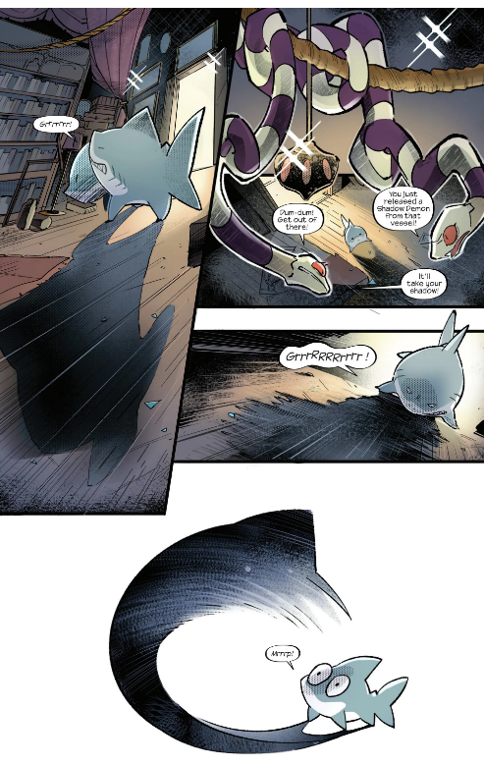
Music fades
Wind noise or scary sound

Slide 13
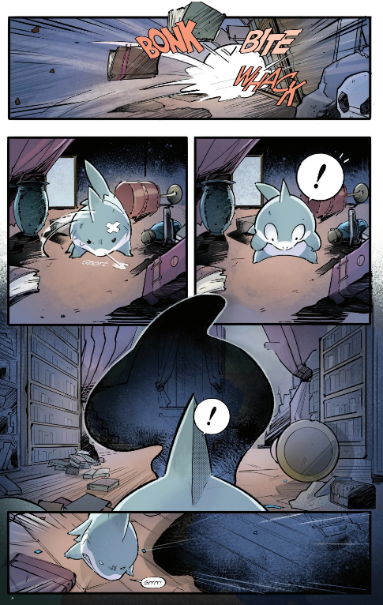
Shuffling of fighting
Grunting noise
"Huh?"
Wind noise
"ahh!"
Scary sound

Slide 14
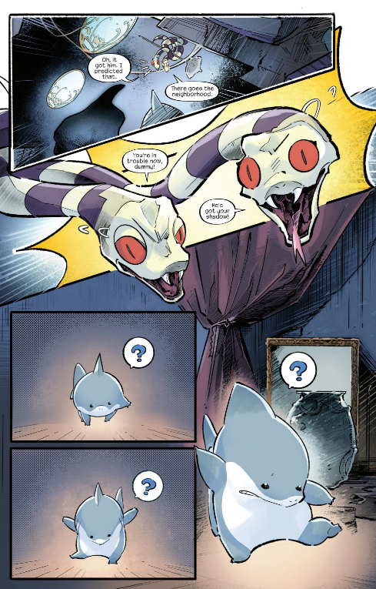
Hiss before “you’re in trouble now dummy”
"Hm?"
Feet padding

Slide 15
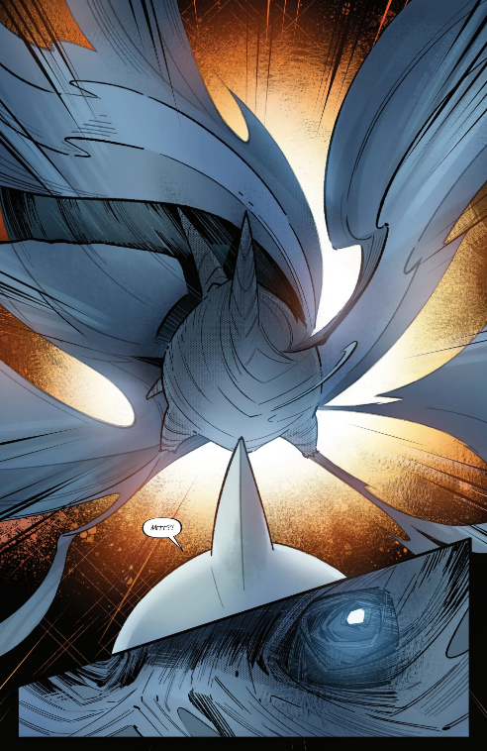
Loud wind noise
Scary sound effect

Slide 16
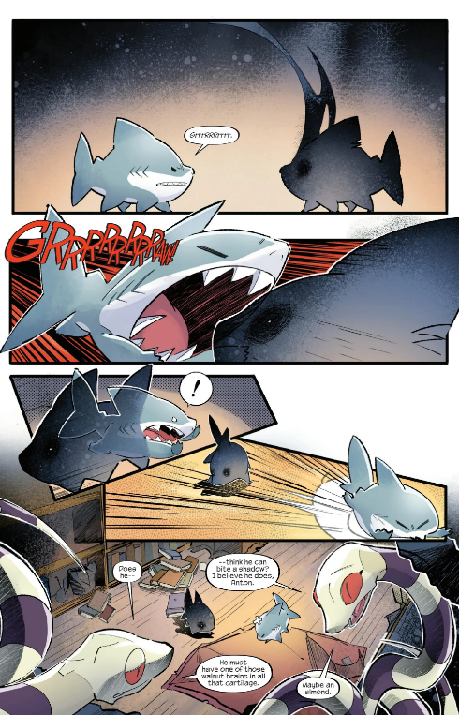
running noise
"Aghhh!!"
Gust of wind
crash

Slide 17
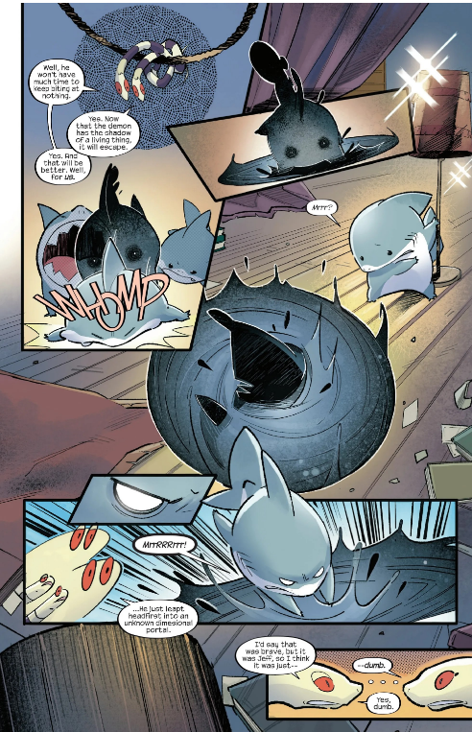
Portal sounds when it appears
chomp
“vwoop” noise

Slide 18
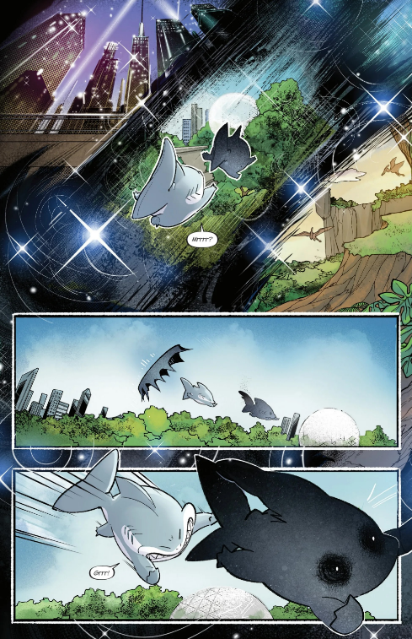
Spacey type music
Two “vwoop” noises
Music fades
Wind noises

Slide 19
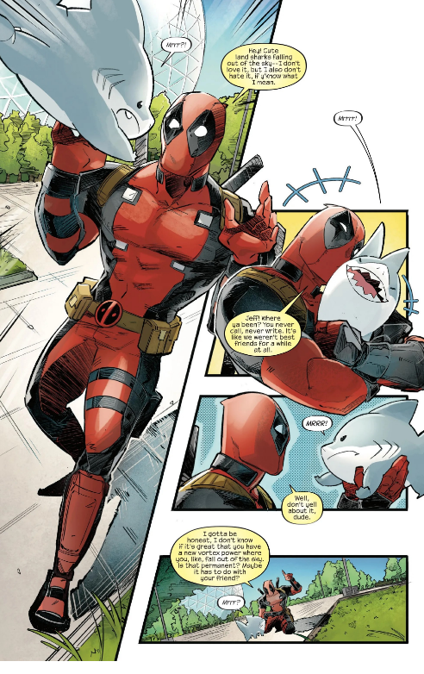
Bird noises with children playing in the background and calming music
Deadpool and jeff laughing
Jeff falling into deadpool

Slide 20
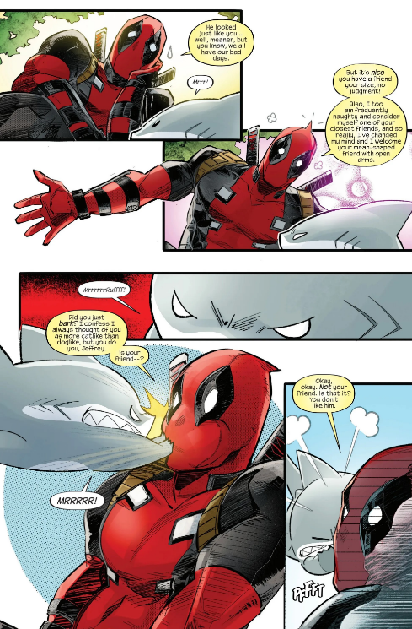
Bird noises with children playing in the background
Thunder noise

Slide 21
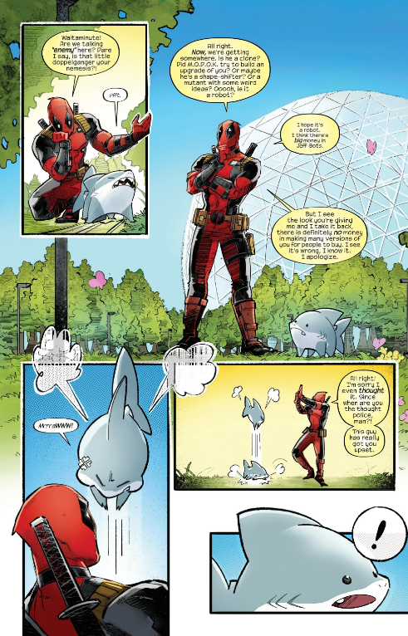
Bird noises with children playing in the background
Jeff jumping
Jeff gasps

Slide 22
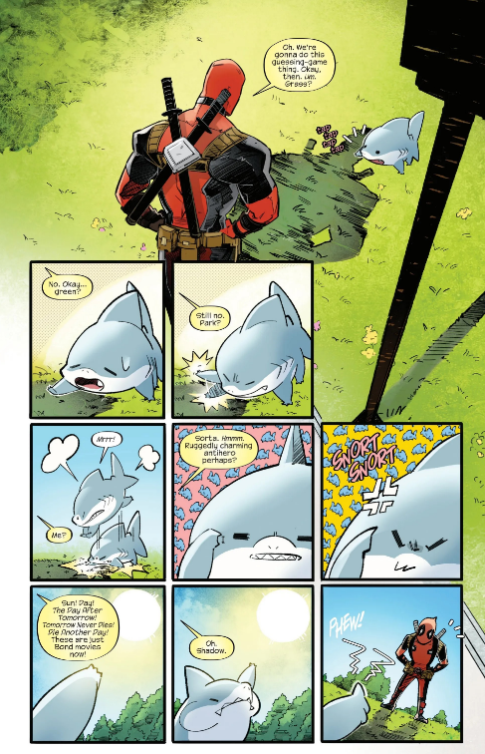
Bird noises with children playing in the background
Jeff panting
Smacking the grass
Jeff whining
Jeff panting

Slide 23
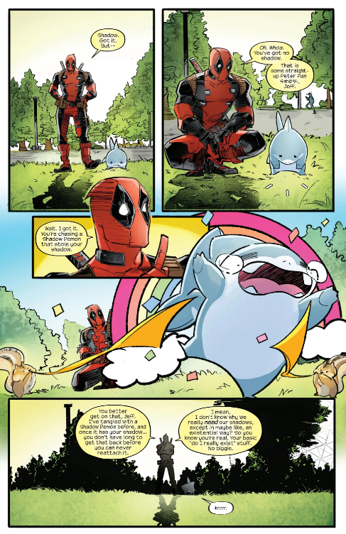
Bird noises with children playing in the background
“Wahoo!!!”
Group of people going “YAYYYY!!!”
popping noise

Slide 24
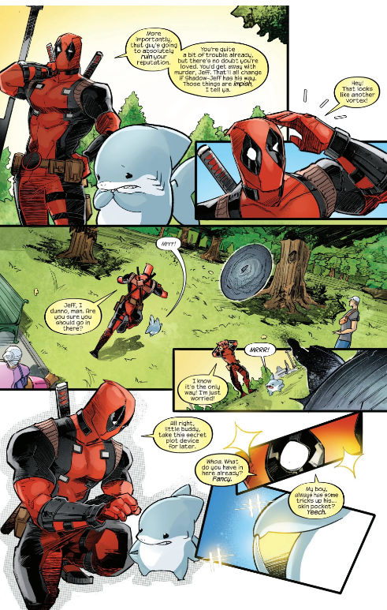
Bird noises with children playing in the background
Jeff whines
Portal sounds
Calming music transitions into hopeful heroic music
Sparkling noises

Slide 25
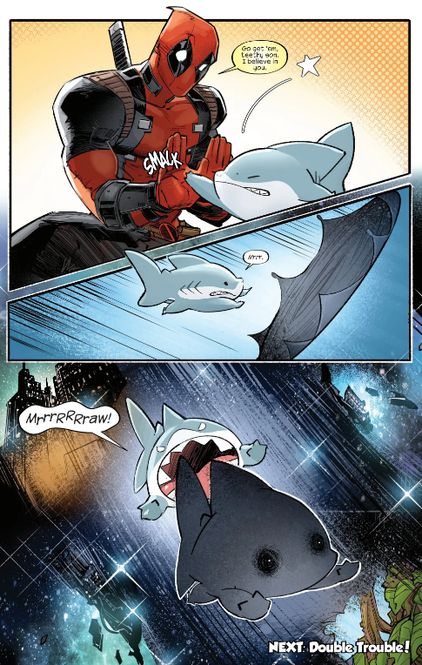
Bird noises with children playing in the background
Bird noises, children playing sounds and music ends
“vwoop” noise
Wind noise
narrator

